Slide 1

REGIONAL INSTITUTE OF SCIENCE & TECHNOLOGY, MEGHALAYA
Run by: ERDF Foundation - Guwahati
Approved by AICTE, New Delhi & Affiliated to NEHU - Shillong
Second Progress Minor Project Presentation on
TRESPASSER DETECTION SYSTEM USING MACHINE LEARNING
Guided by
Mr. Abdul Kayum Ali
Asst. Professor, CSE
Presented by-
Atifa Zaman | 21RISTCSE002
Ibrahim Ishtiaque Ali | 21RISTCSE009
Madhurjya Das | 22RISTLCS004

Slide 2
CONTENT
INTRODUCTION | 3
CONTINUATION OF LITERATURE SURVEY | 4
OBJECTIVES | 5
METHODOLOGY | 6
SDLC MODEL | 8
DESIGN | 9
TESTING | 13
CONCLUSION AND FUTURE WORK | 17
REFERENCES | 18

Slide 3
INTRODUCTION
In the era of security, unauthorized access of individuals into a restricted area can lead to a major security collapse.
To prevent from security collapse, detection and identification of individuals are necessary for the enhancement of security and safety of a particular area.
A trespasser detection system using machine learning algorithms to provide accurate, real-time identification of unauthorized access.
Using Machine Learning algorithms, we detect and recognize human figures in images or real time video feed.

Slide 4
LITERATURE SURVEY
Sl No. | Title | Methodology | Dataset | Drawbacks | Result
15. | An Effective Trespasser Detection System using Video Surveillance Data | Motion object detection using Gaussian Mixture Model (GMM) Classification and trespasser detection based on bounding box matching with restricted area. | Custom dataset with 60 video clips. | Lighting Sensitivity, dependence on human motion characteristics, limited to human detection | 100% precision in normal lighting 94.74% accuracy in uneven illumination. 89.16% accuracy in noisy environments. Overall average accuracy of over 94%.
16. | A Deep Learning Approach to Trespassing Detection using Video Surveillance Data | Frame filtering for activity detection. Faster R-CNN for object detection. Evaluation using F1 Score and AUC. | Custom video clip dataset. | Performance sensitive to noise and thresholds limited to human detection. | AUC: 0.81, Time: 500 ms F1 Score : 0.89 at a threshold of 0.3.

Slide 5
OBJECTIVES
To detect motion of a person entering the frame of the CCTV camera.
To detect a human intruder using Machine Learning techniques.
To send alerts to the user when unknown person is identified.

Slide 6
METHODOLOGY
Algorithm:
Start
Collection of dataset of trespasser images.
Augmentation and labelling of the data for better accuracy.
Dividing the data into three parts for training, testing and validation.
Training model according to required dataset.
Load the model with detect module.
Open the input video file and process each frame.
If the frame cannot be read break the loop.
Run object detection on the frame.
Draw bounding boxes and labels on the detected objects.
Write the processed frame to the output video file.
Stop

Slide 7
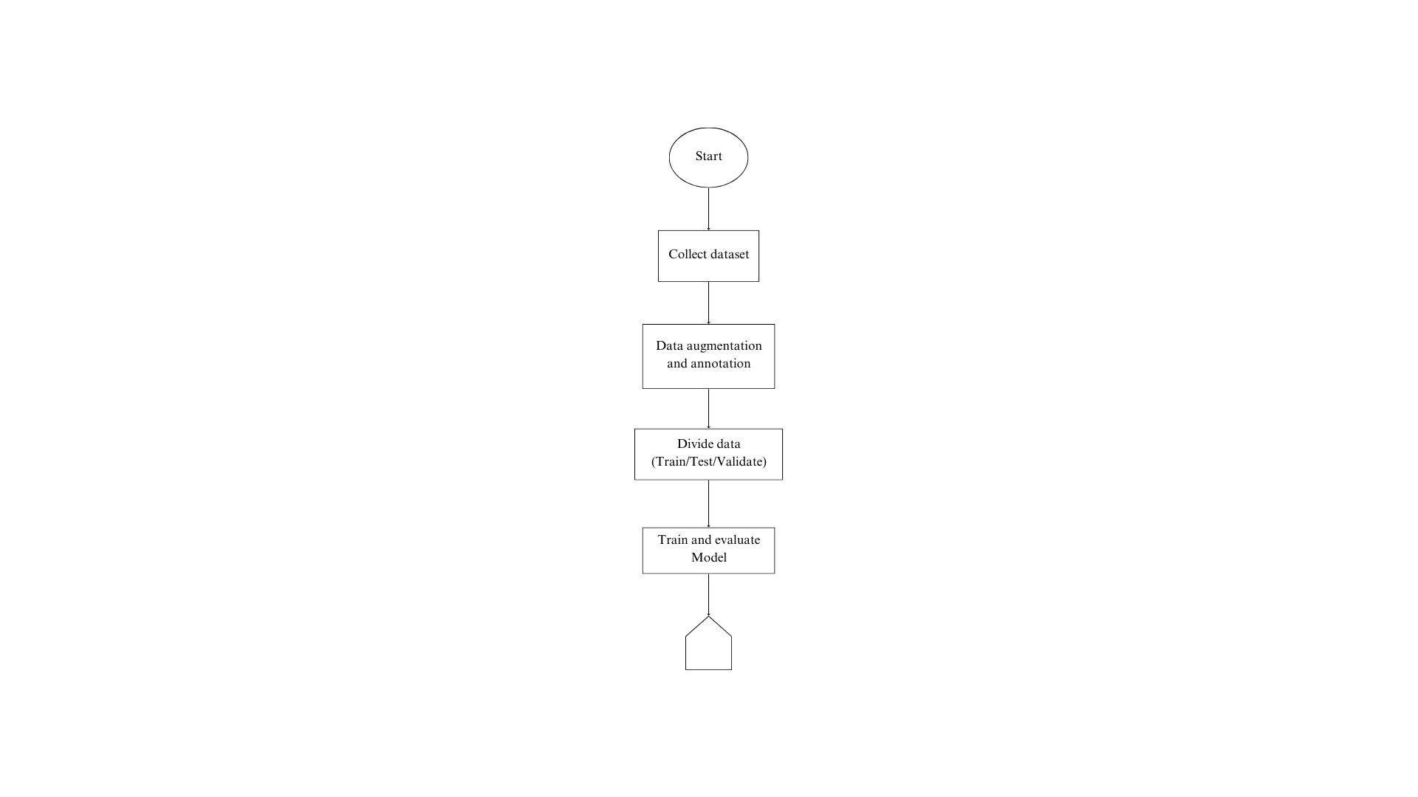
Flowchart:
A

Slide 8
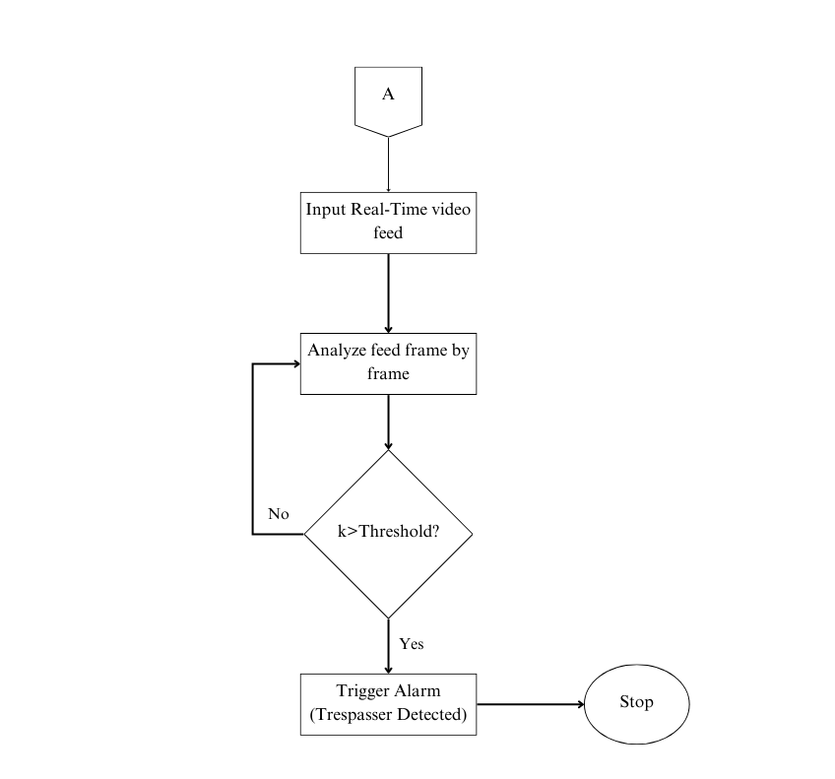
Fig: Flowchart

Slide 9
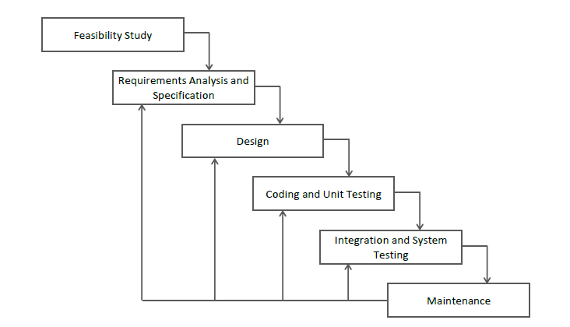
SDLC MODEL
Fig: Iterative Waterfall Model

Slide 10
DESIGN
The design of the project includes the flowing:
DFD of the model: visual representation of the flow of information within a system.
Use case of the model: List of actions or event steps that describe how a user uses a system to accomplish a particular goal.

Slide 11
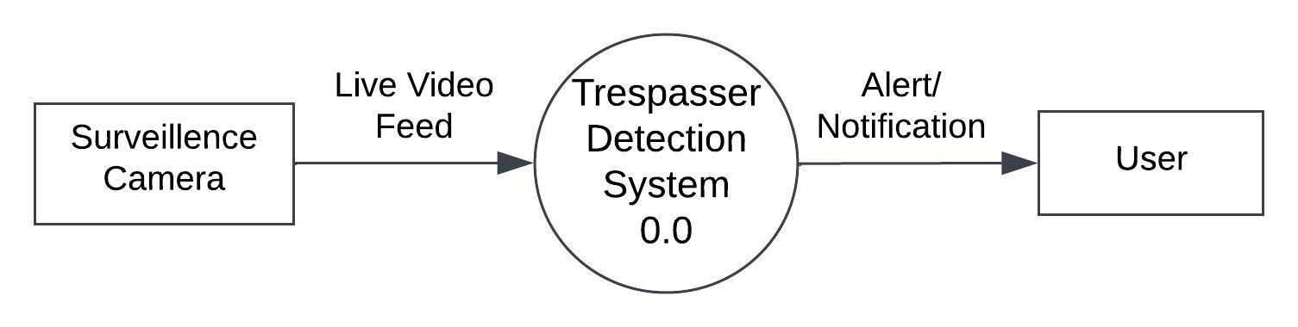
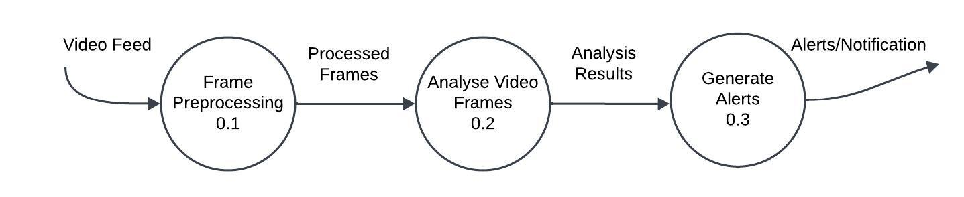
DATA FLOW DIAGRAM
Level 0
Level 1

Slide 12
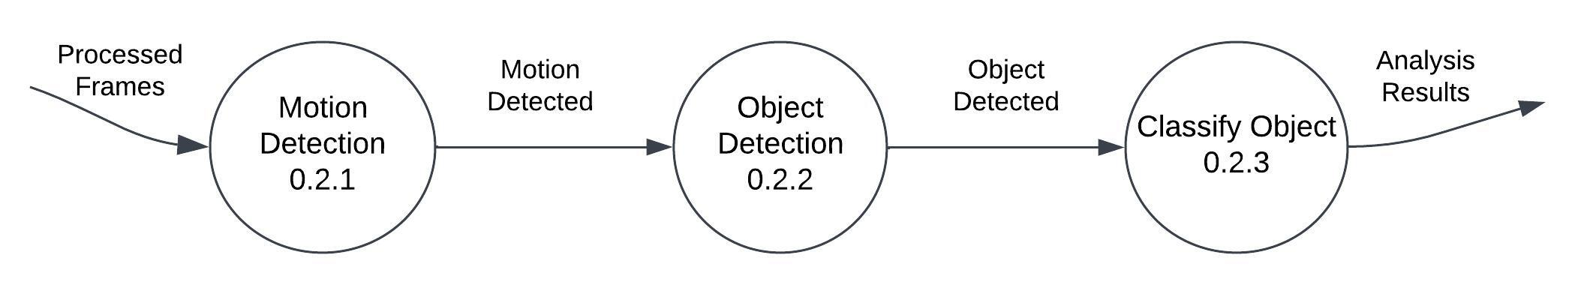
Level 2

Slide 13
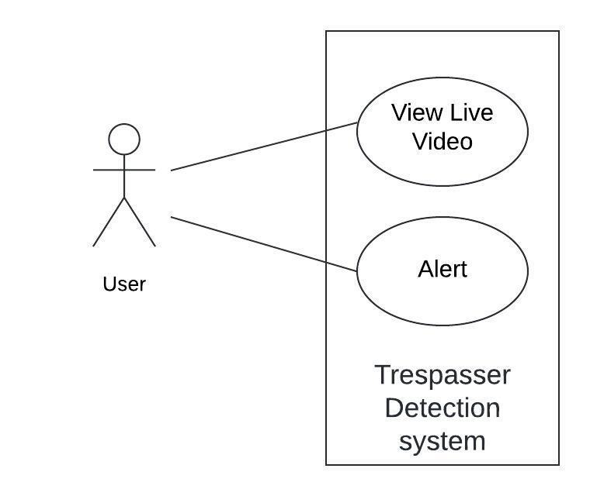
USE CASE
Fig: Use case diagram

Slide 14
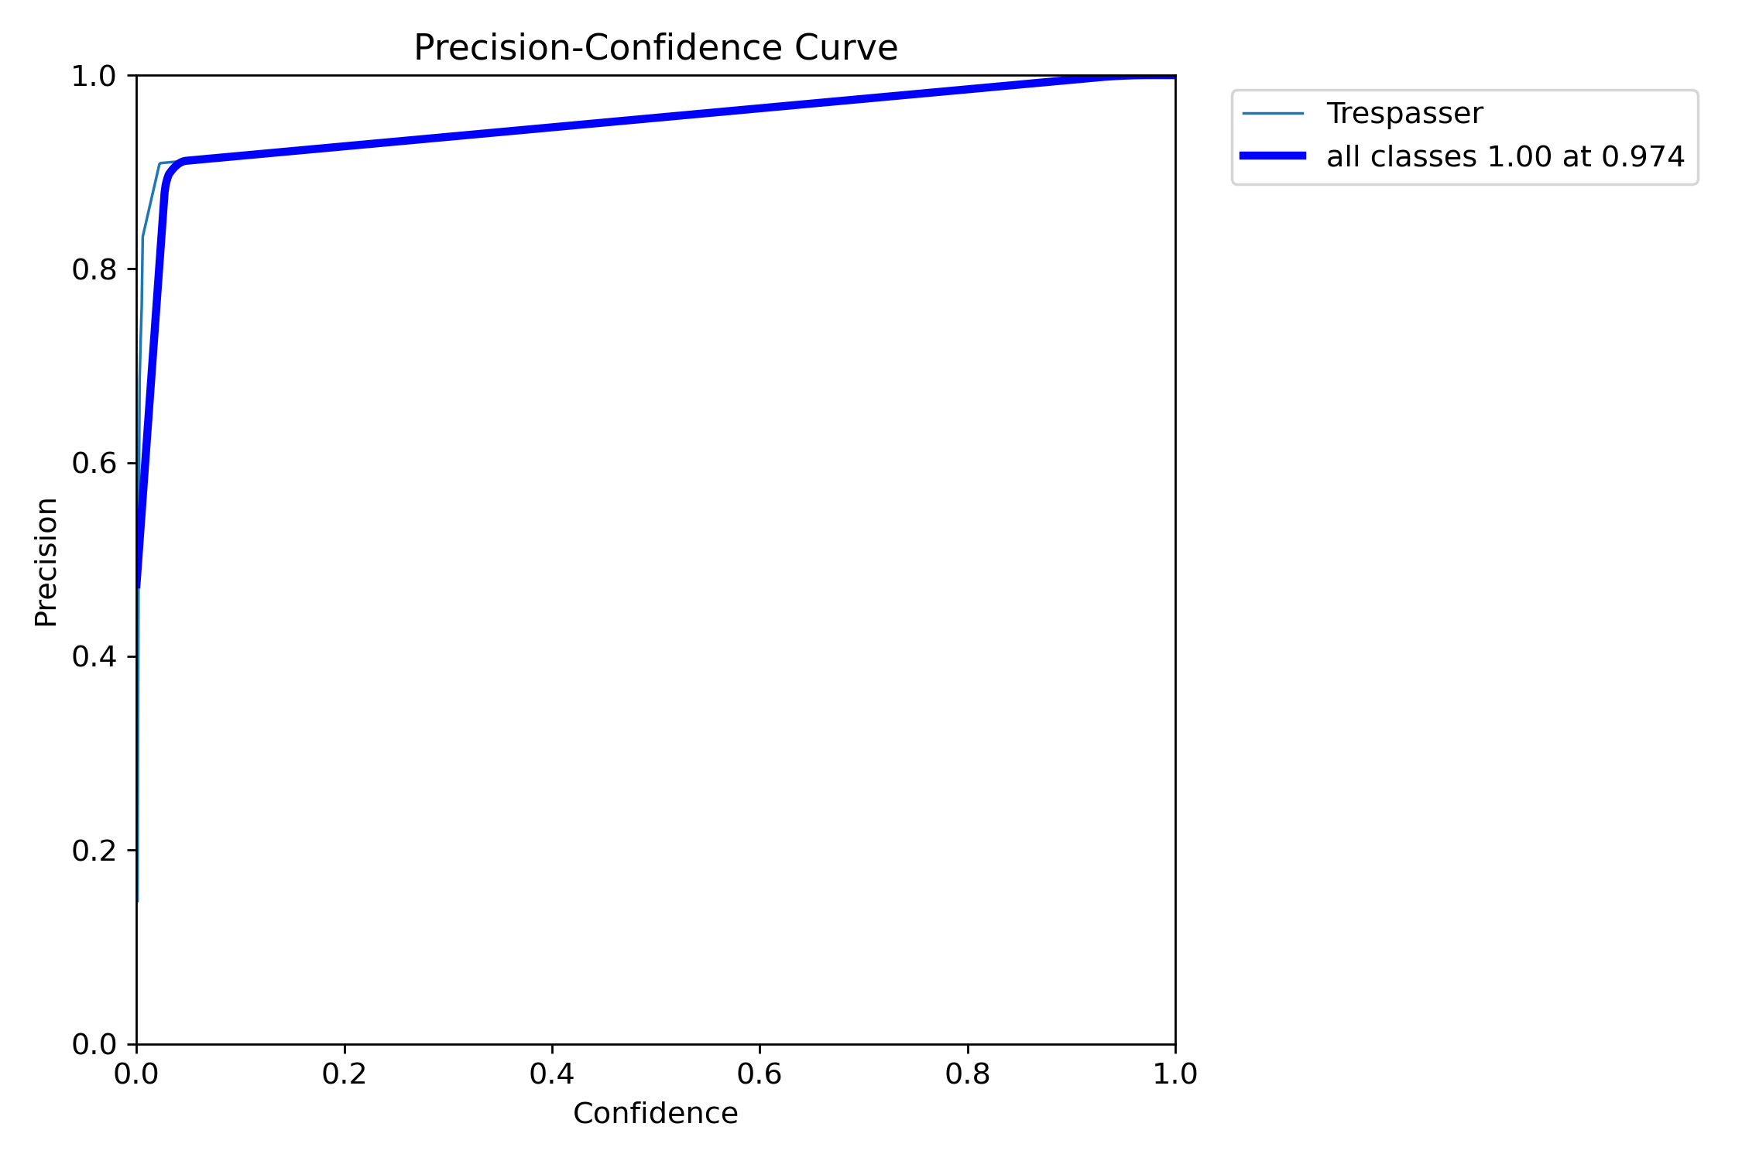
TESTING
PERFORMANCE OF THE MODEL:
Fig: Precision-Confidence Curve

Slide 15
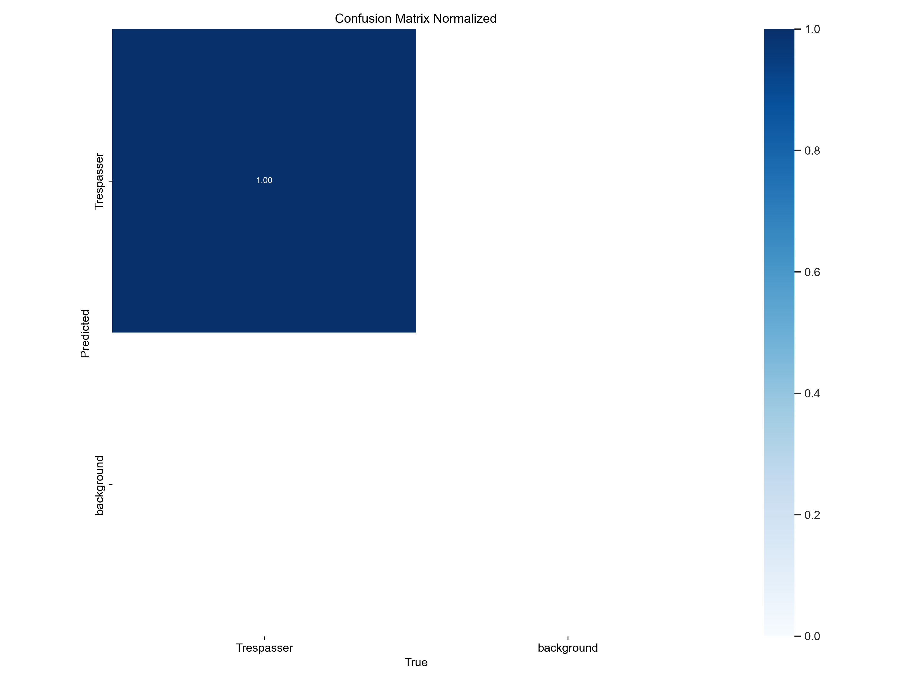
Fig: Confusion Matrix

Slide 16
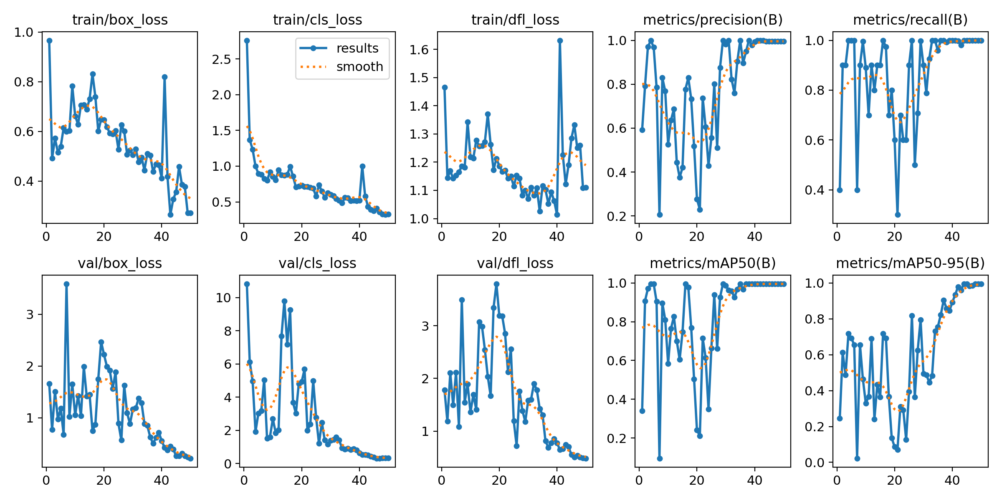
Fig: Training and Validation Loss

Slide 17
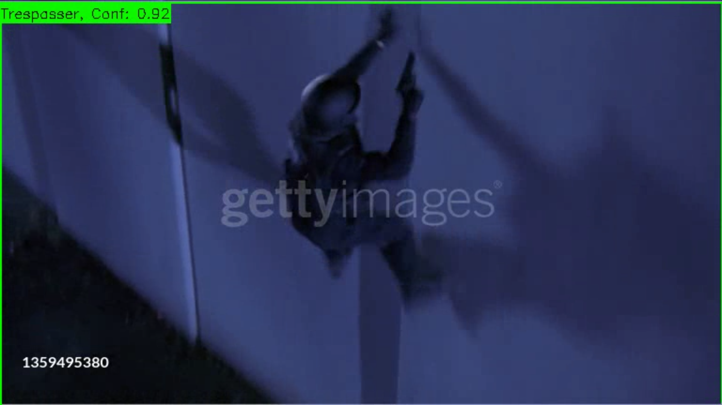
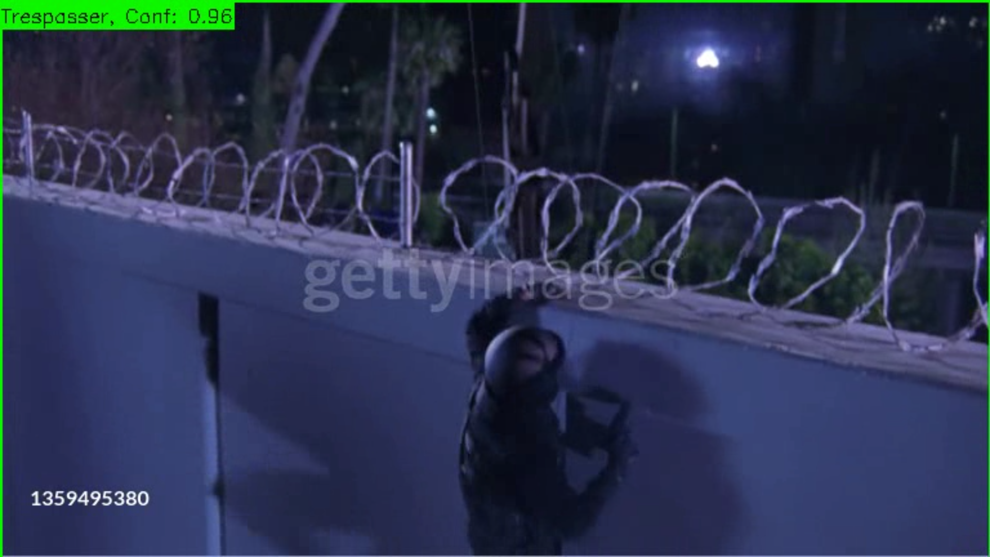
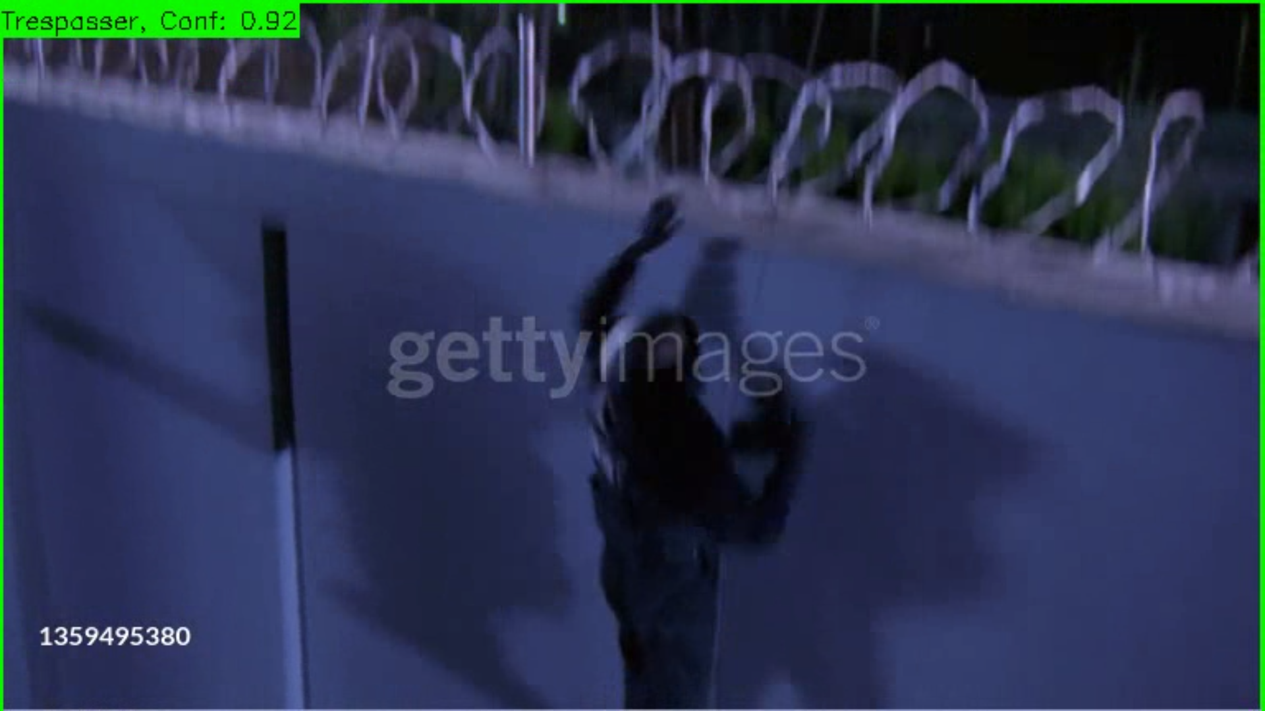
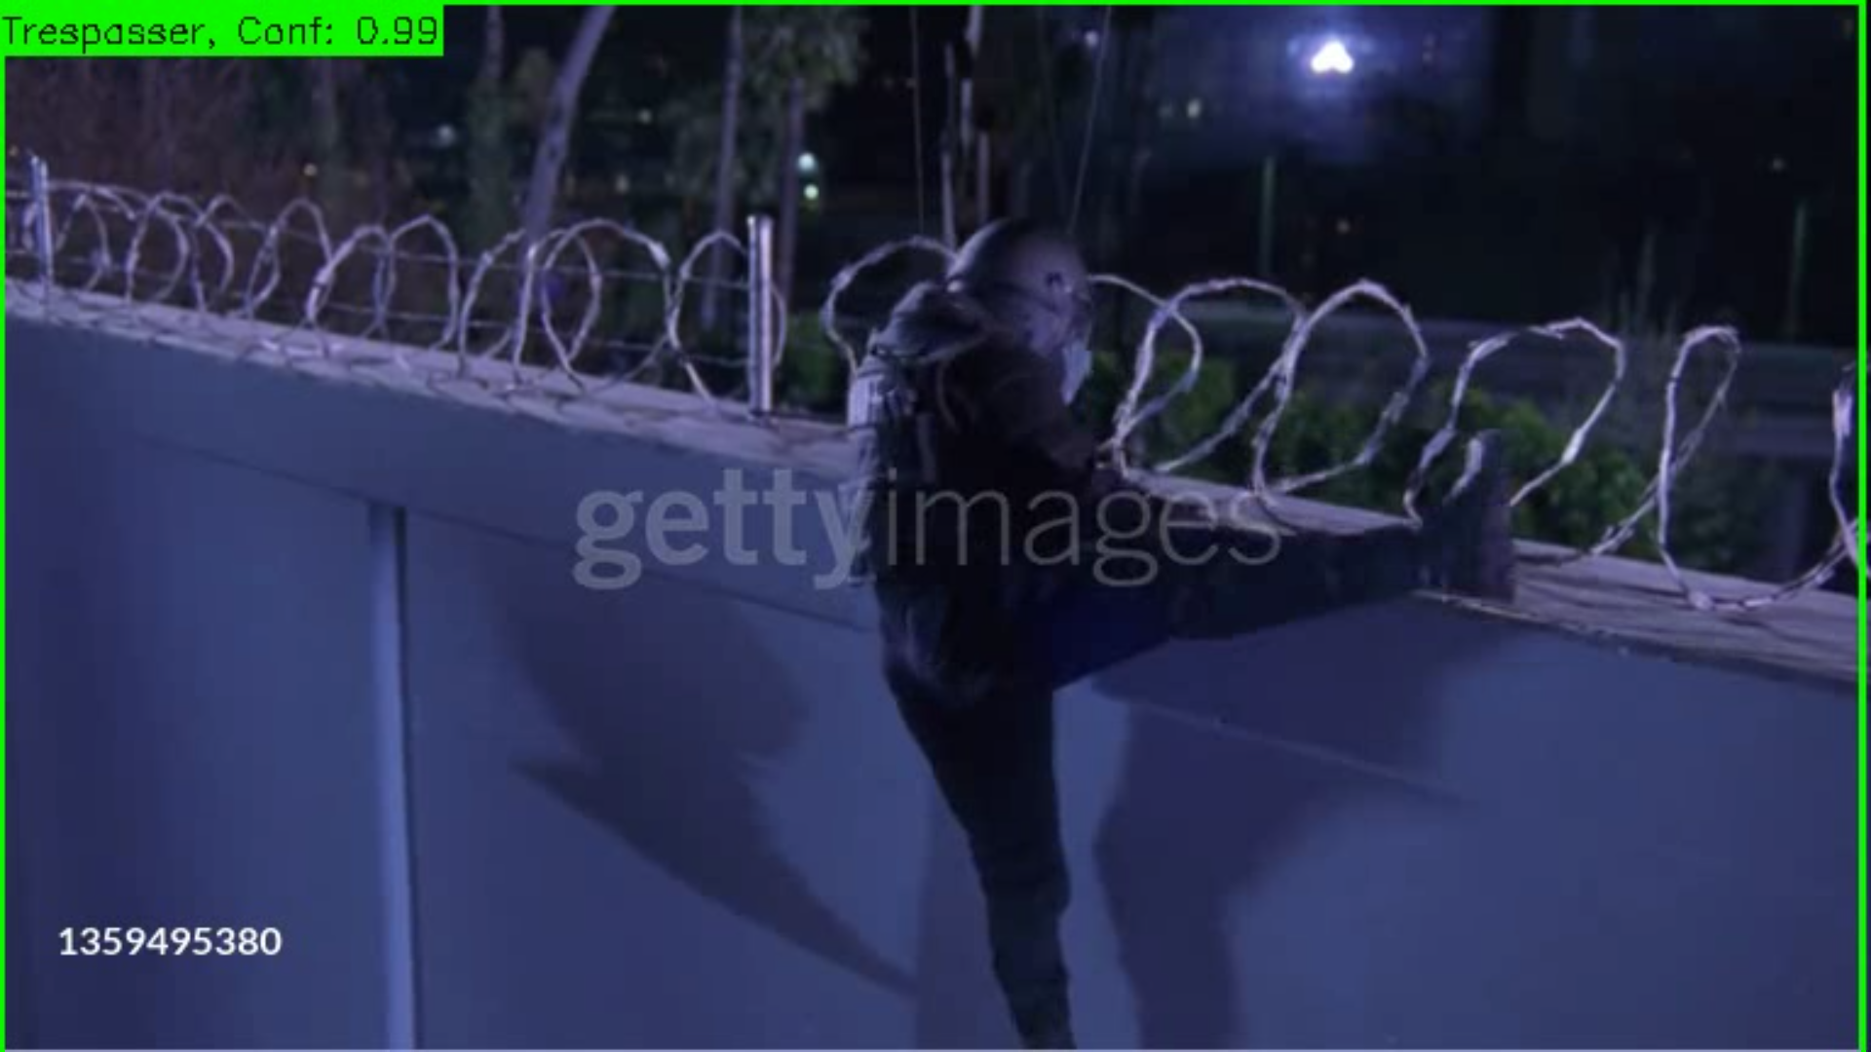
Fig: Screenshots of output of the program

Slide 18
CONCLUSION AND FUTURE WORK
The second objective of our project successfully implemented as real-time trespasser detection is done.
Captured video frames are processed to detect trespassers after training the model.
In the next phase, our aim is to implement the alarm function after identifying trespassers.

Slide 19
REFERENCES
[15] Chal, W. M., & Zar, K. T. (2020, November). An Effective Trespasser Detection System using Video Surveillance Data. In 2020 International Conference on Advanced Information Technologies (ICAIT) (pp. 135-140). IEEE.
[16] Bashir, M., Rundensteiner, E. A., & Ahsan, R. (2019, December). A deep learning approach to trespassing detection using video surveillance data. In 2019 IEEE International Conference on Big Data (Big Data) (pp. 3535-3544). IEEE.

